Slide 1
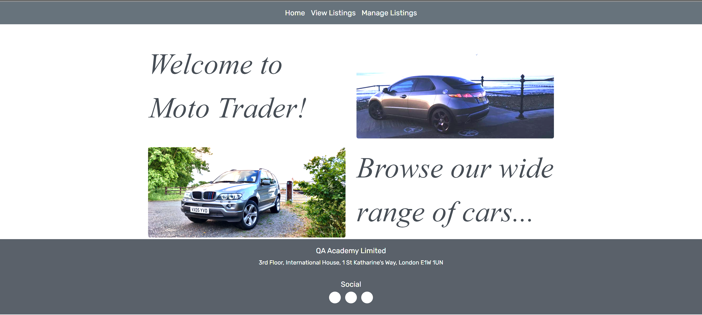
Assessment 2 Hobby Project QA Academy
M Chocianowski

Slide 2

Assessment Objective
This is my second assessment with the academy, this project is known as the hobby project and will and is intended to prove my knowledge and understanding of providing a Crud functional application with a back-end and front-end.

Slide 3
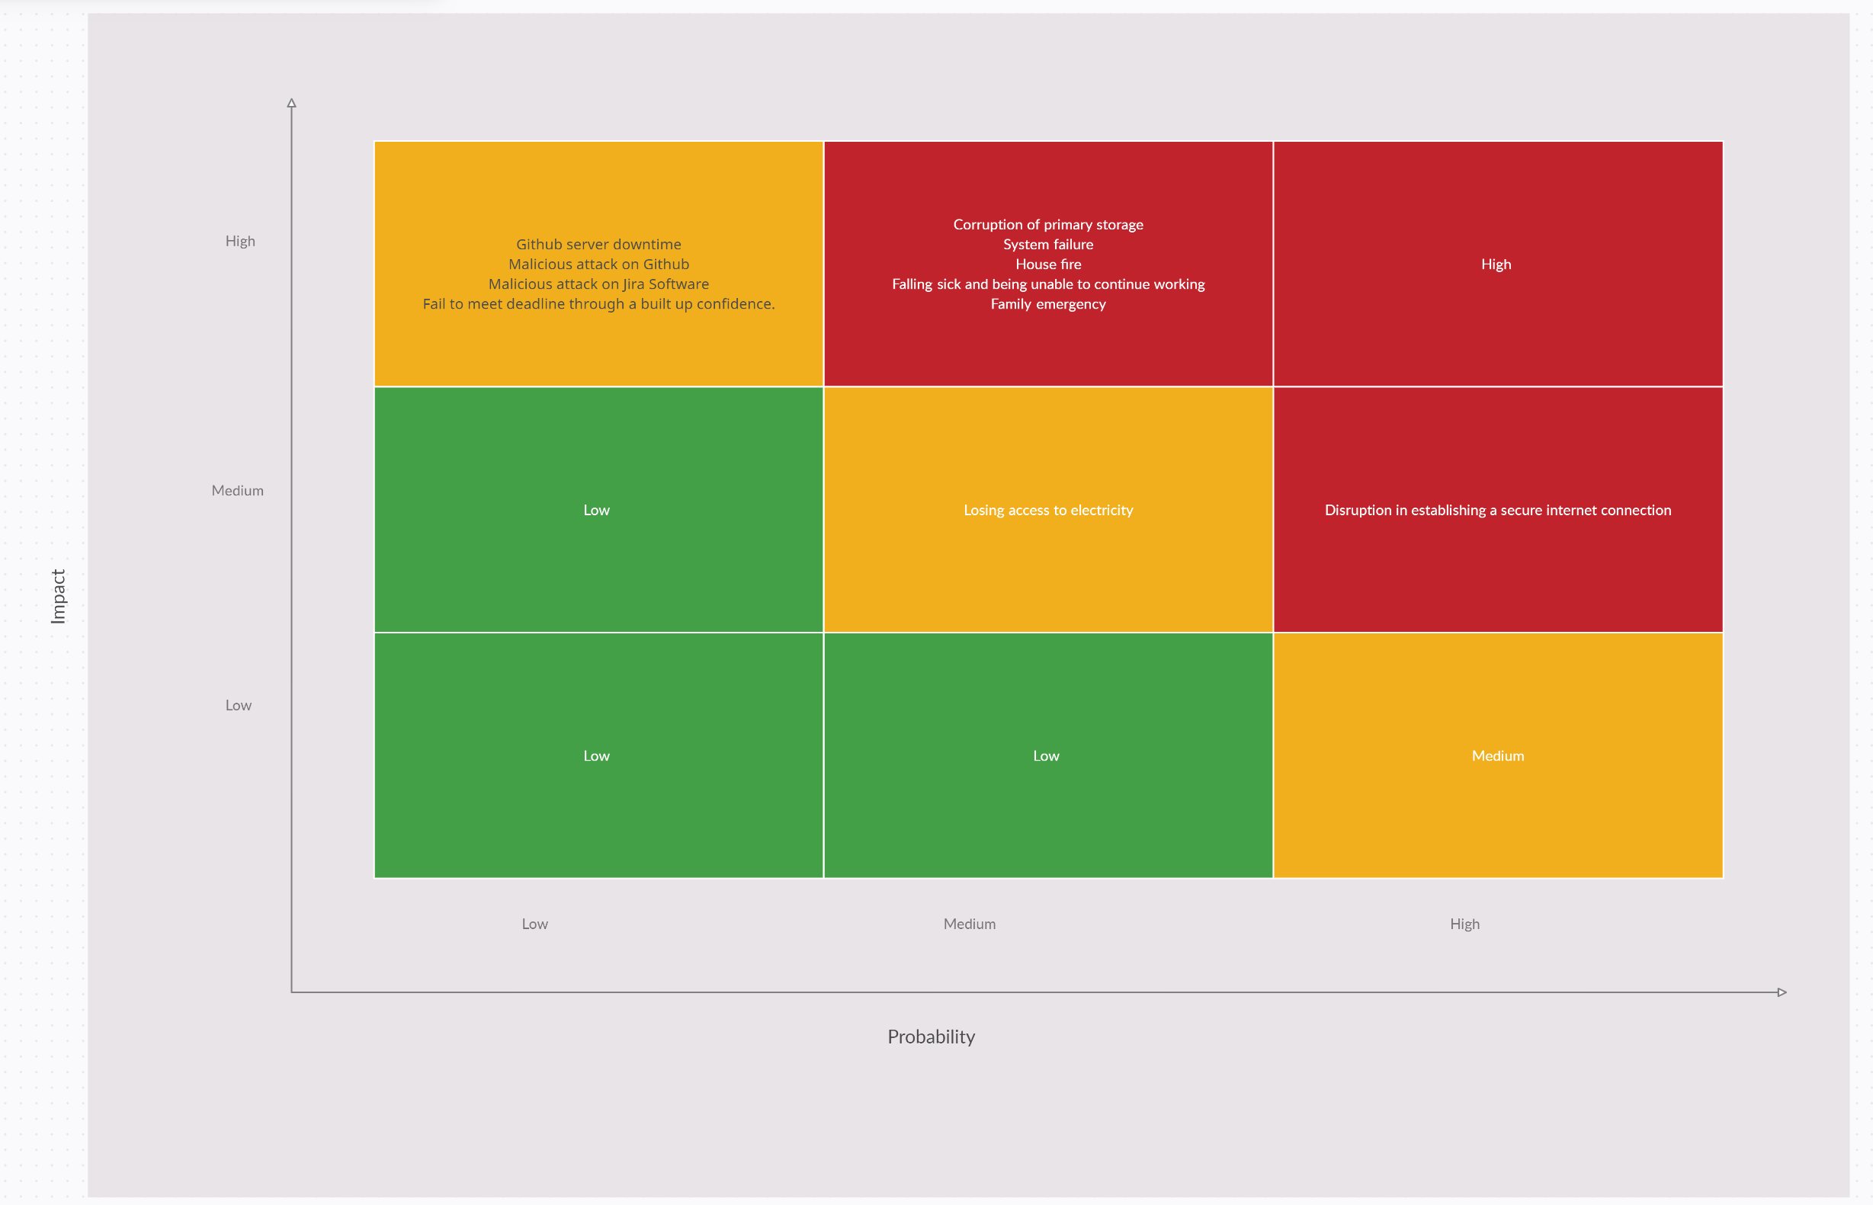
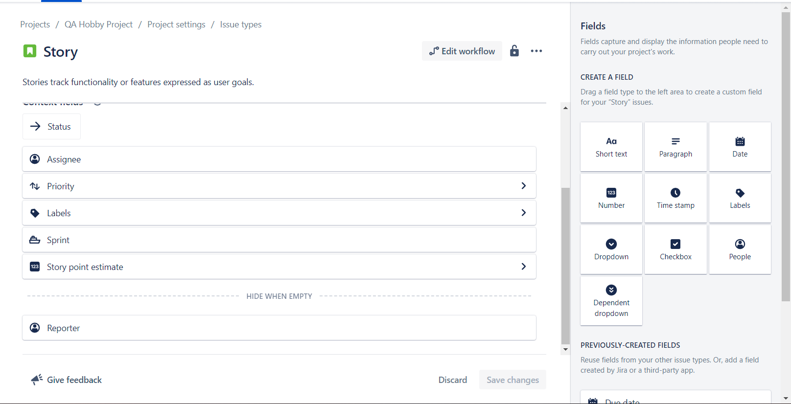
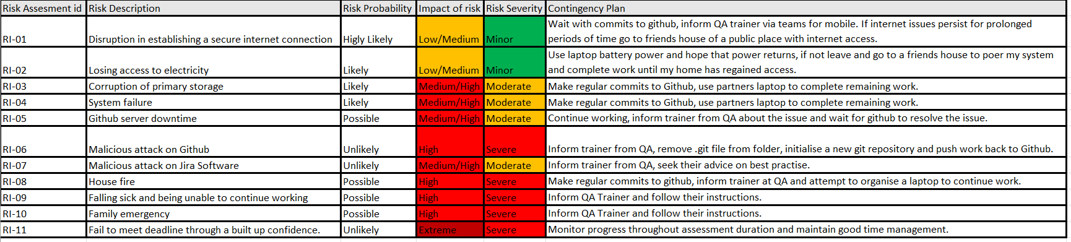
Planning
Jira
Risk Assessment
Risk Assessment Matrix

Slide 4
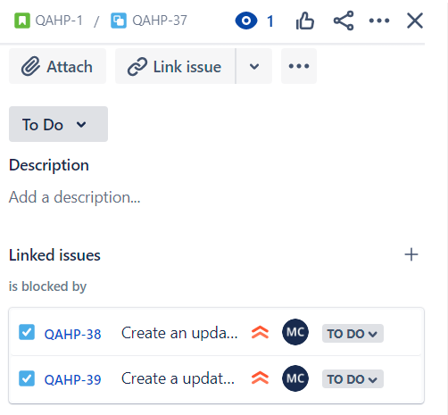
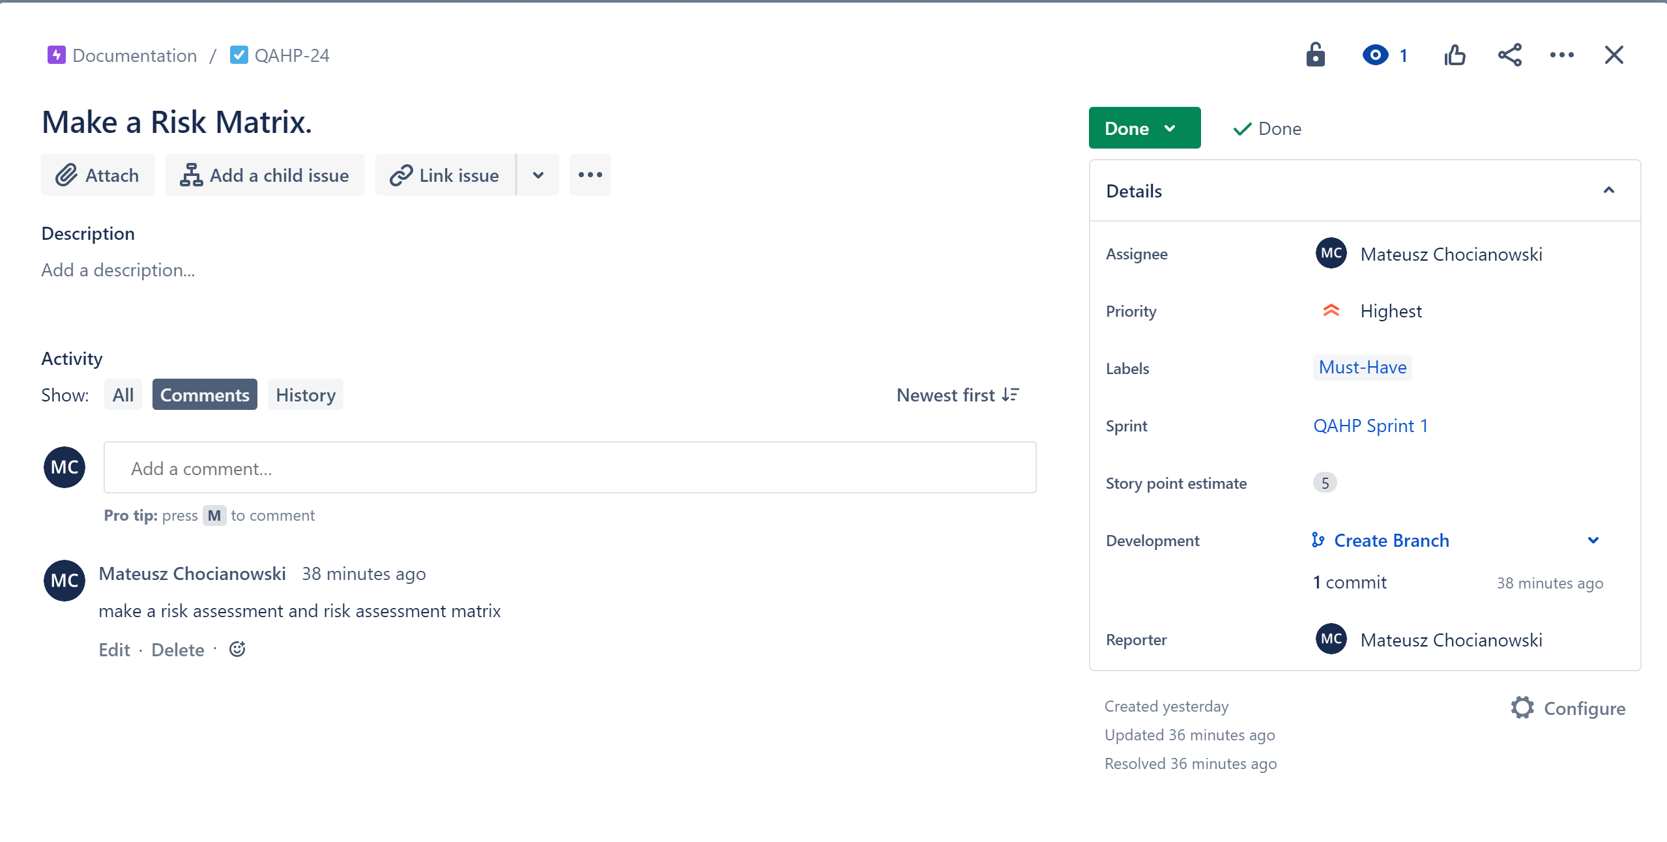
Jira
Adding child issues and linked issues to user stories
Adding fields to issues in settings
Linking GitHub and Jira to implement commit messages

Slide 5
Risk assessment And Risk Matrix

Slide 6
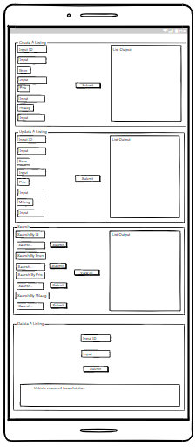
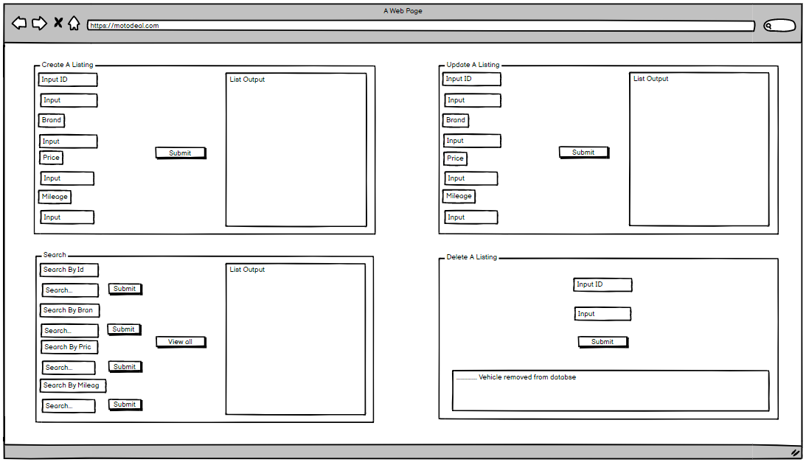
Initial Wireframes

Slide 7
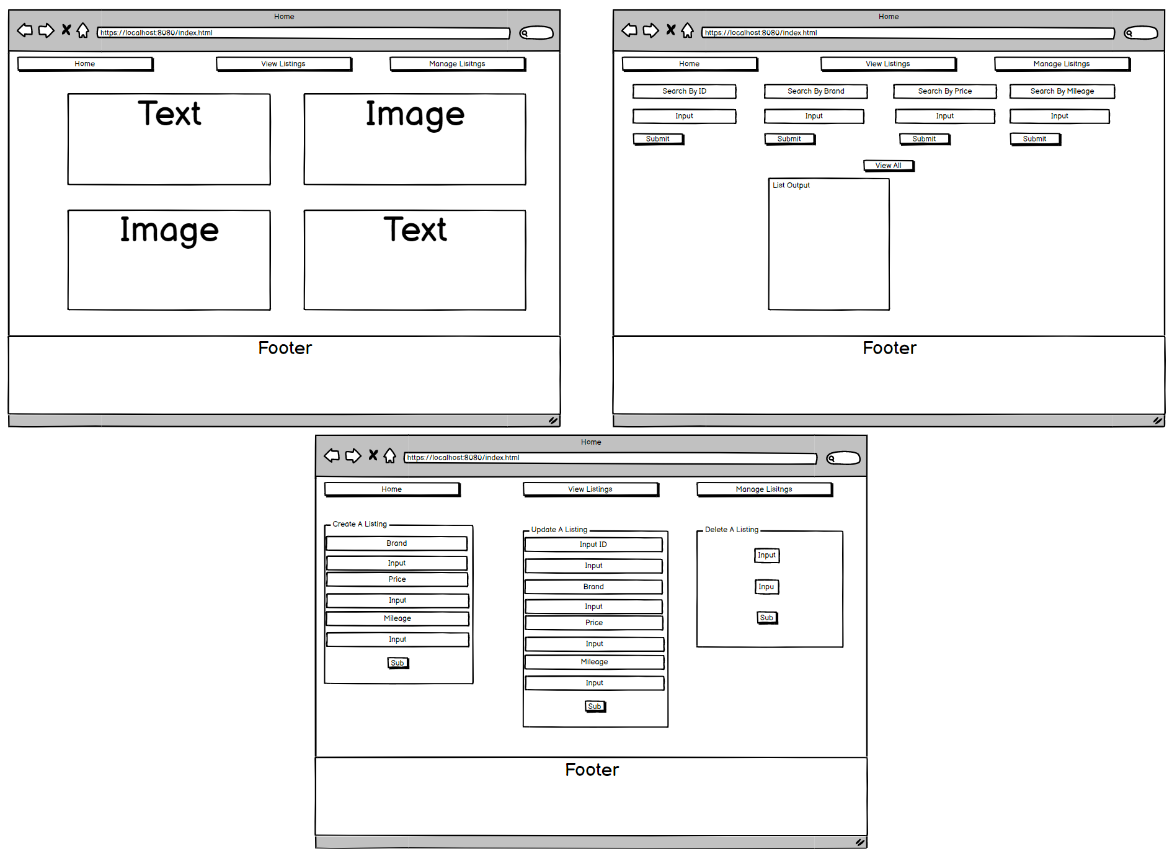
Final Wireframes

Slide 8
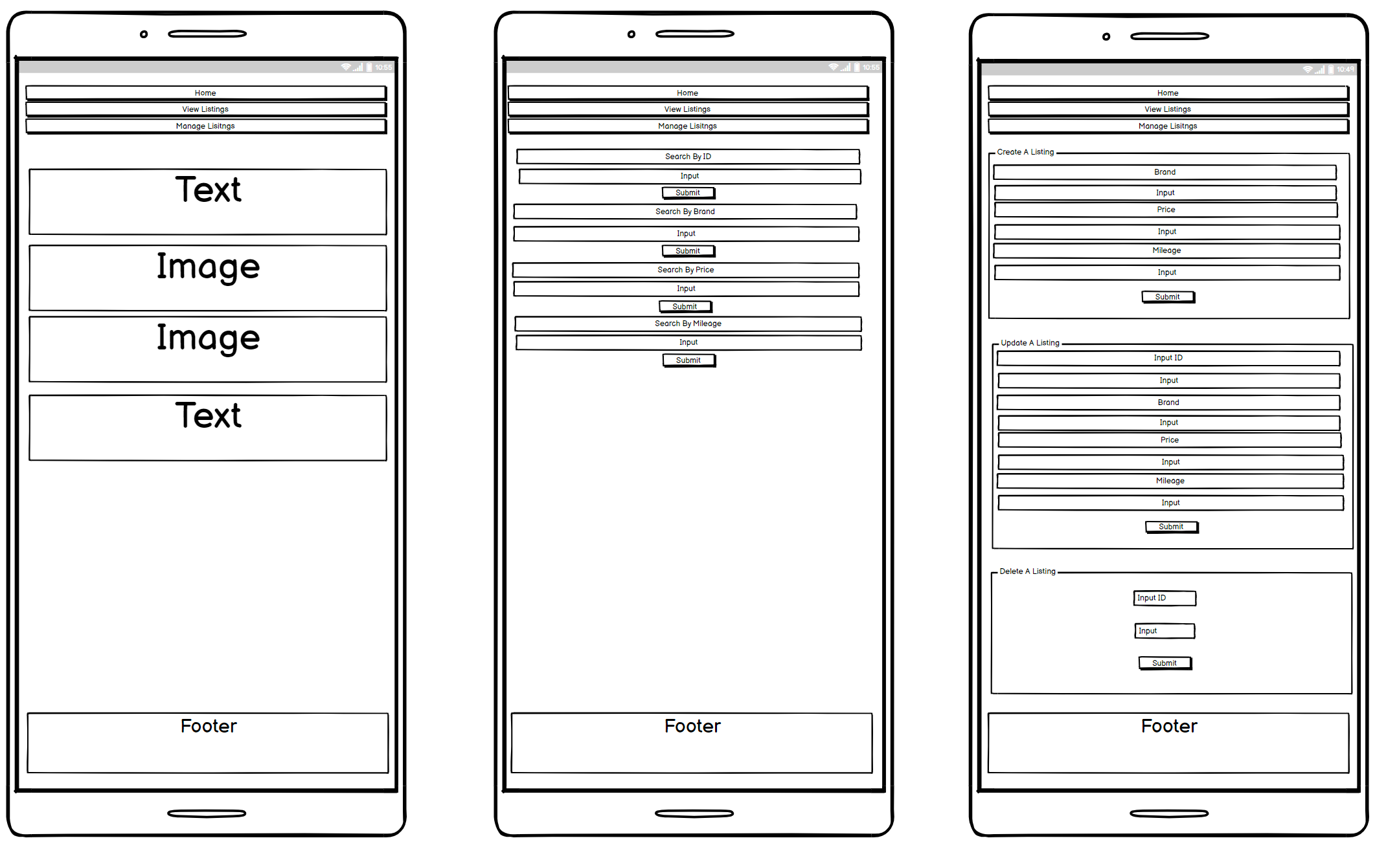
Final Wireframes

Slide 9




Technologies
HTML
CSS, Bootstrap
JavaScript
Java

Slide 10




Technologies
Jira
Github
Maven
MySQL

Slide 11




Technologies
Eclipse
Spring Boot
VS Code
Postman

Slide 12
Summary
What Went Well
What Could Have Been Better
The MVP was met.
Good use of smart commits.
Good use of feature branching in Github.
Jira Planning could have been more in depth.
More progression screenshots.

